Slide 1


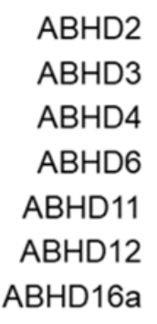

CBK600192 (TH14125) – Literature Inhibitor
CBK600192 (TH14125) is a literature inhibitor of ABHD2.
ACS Chem. Biol. 2019, 14, 10, 2295–2304.

Slide 2
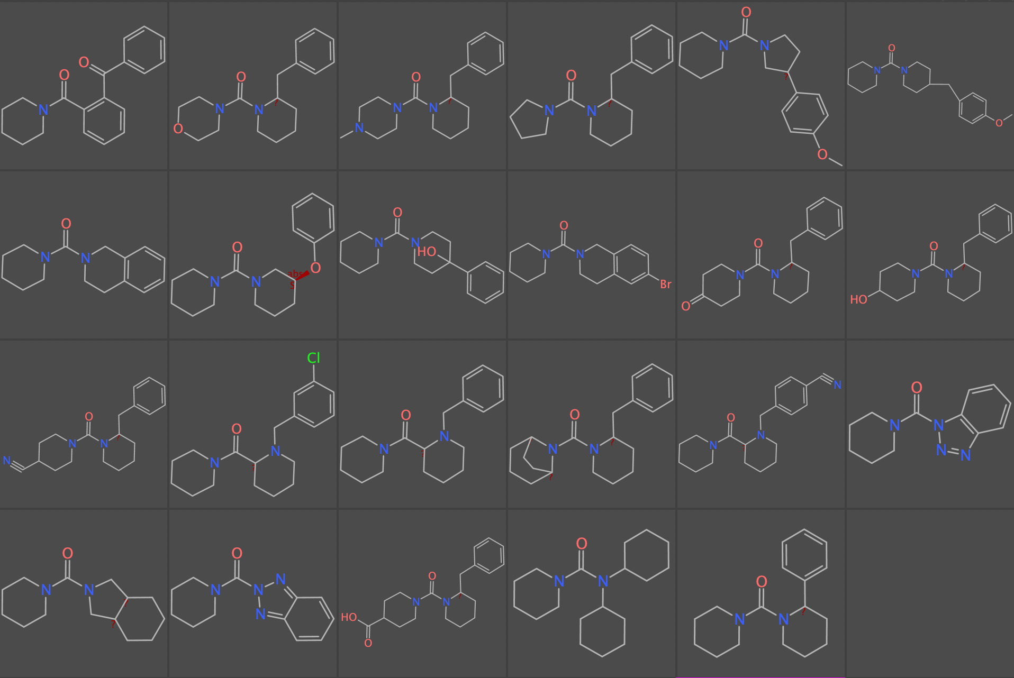
CBK600192 (TH14125) Analogues
These are analogues of CBK600192 (TH14125) that were synthesised by Pauline Ribera (Karolinska Institutet).

Slide 3
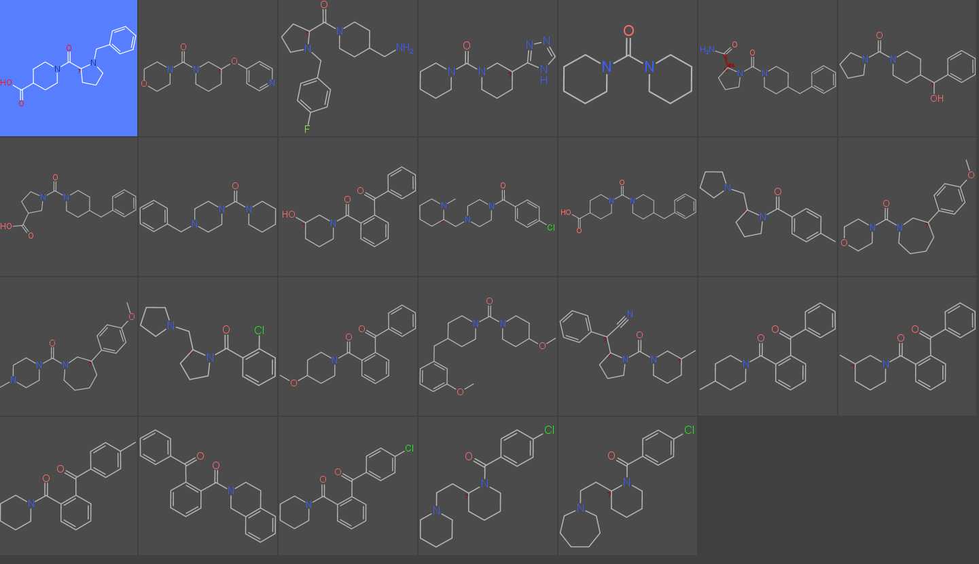
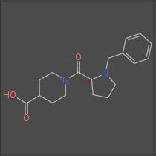
CBK600192 (TH14125) Analogues
These are analogues of CBK600192 (TH14125) that were purchased by Evert Homan (Karolinska Institutet).

Slide 4
Enantiomers of CBK600192 (TH14125)
TH14125
ACS Chem. Biol. 2019, 14, 10, 2295–2304.

Slide 5
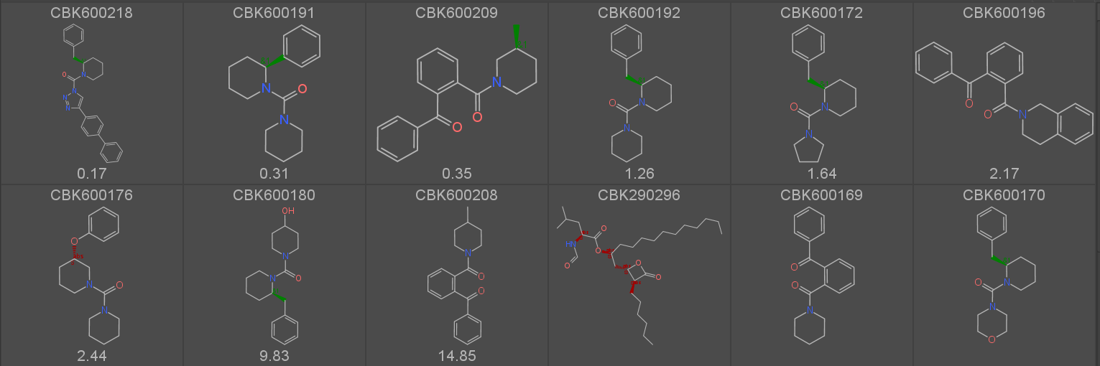

Oliver’s IC50 results so far
We will look at purchasing or synthesising analogues of the best hits.

Slide 6
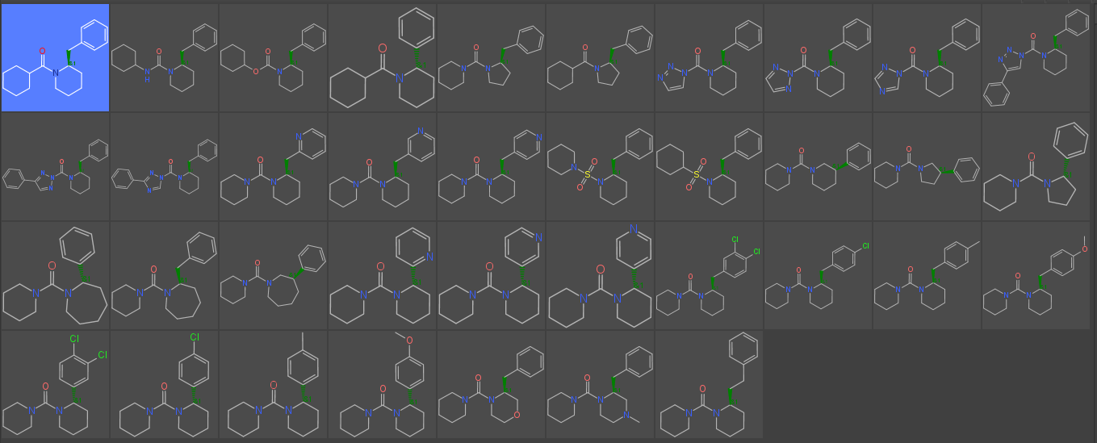
Future CBK600192 (TH14125) Analogues
Evert Homan has designed this list of CBK600192 (TH14125) derivatives that would be sensible to buy or synthesise.

Slide 7
Boryl Compounds
J. Am. Chem. Soc. 2014, 136, 17669−17673; Nat. Comm. 2017, 8, Article number: 1760

